Slide 1
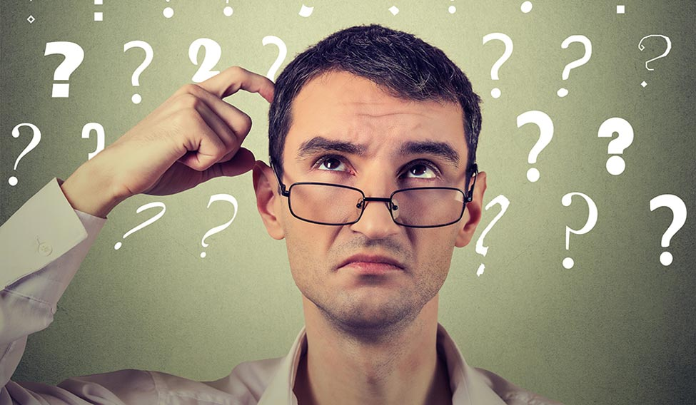
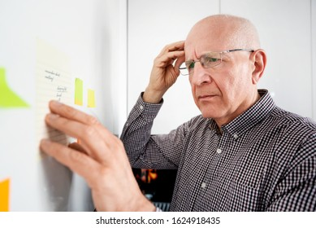

Notes:
every forget to do homework due at 9pm, cant manage your time properly, and cant recall what happened when you went to school the day before?

Slide 2

n o t e d
Notes:
news for you, you got dementia

Slide 3

noted
a repository for your memory
Notes:
welcome to noted, a repository for your memory.

Slide 4
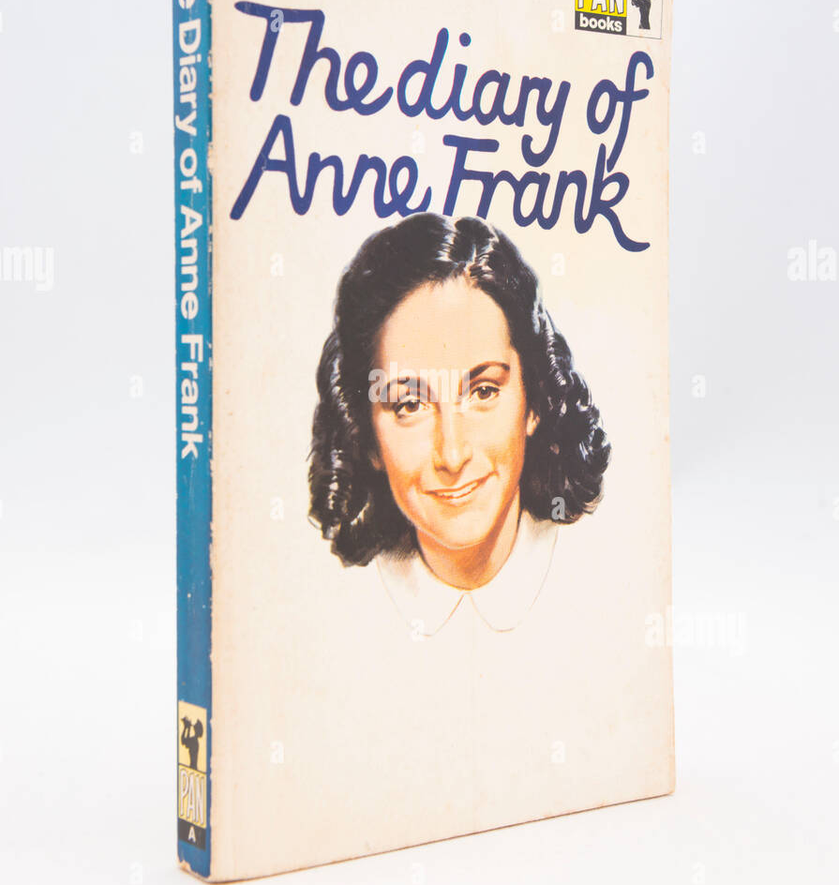
project idea
Notes:
Talk about personal experience when writing a diary I built a habit of reflecting upon myself more often. kept as a record of daily life to look back on in the future.

Slide 5


target audience
Notes:
you, as well as people in the slides (elderly, working adults)

Slide 6
target audience - students
organize their homework and write down their experiences for a good laugh when they mature and look back on their past selves

Slide 7
target audience - adults
help them organize their errands, events and meetings, as well as aid them to reflect upon their daily actions

Slide 8
target audience - elderly
serve as a repository in place of their memory, in the unfortunate event that their memory starts worsen

Slide 9
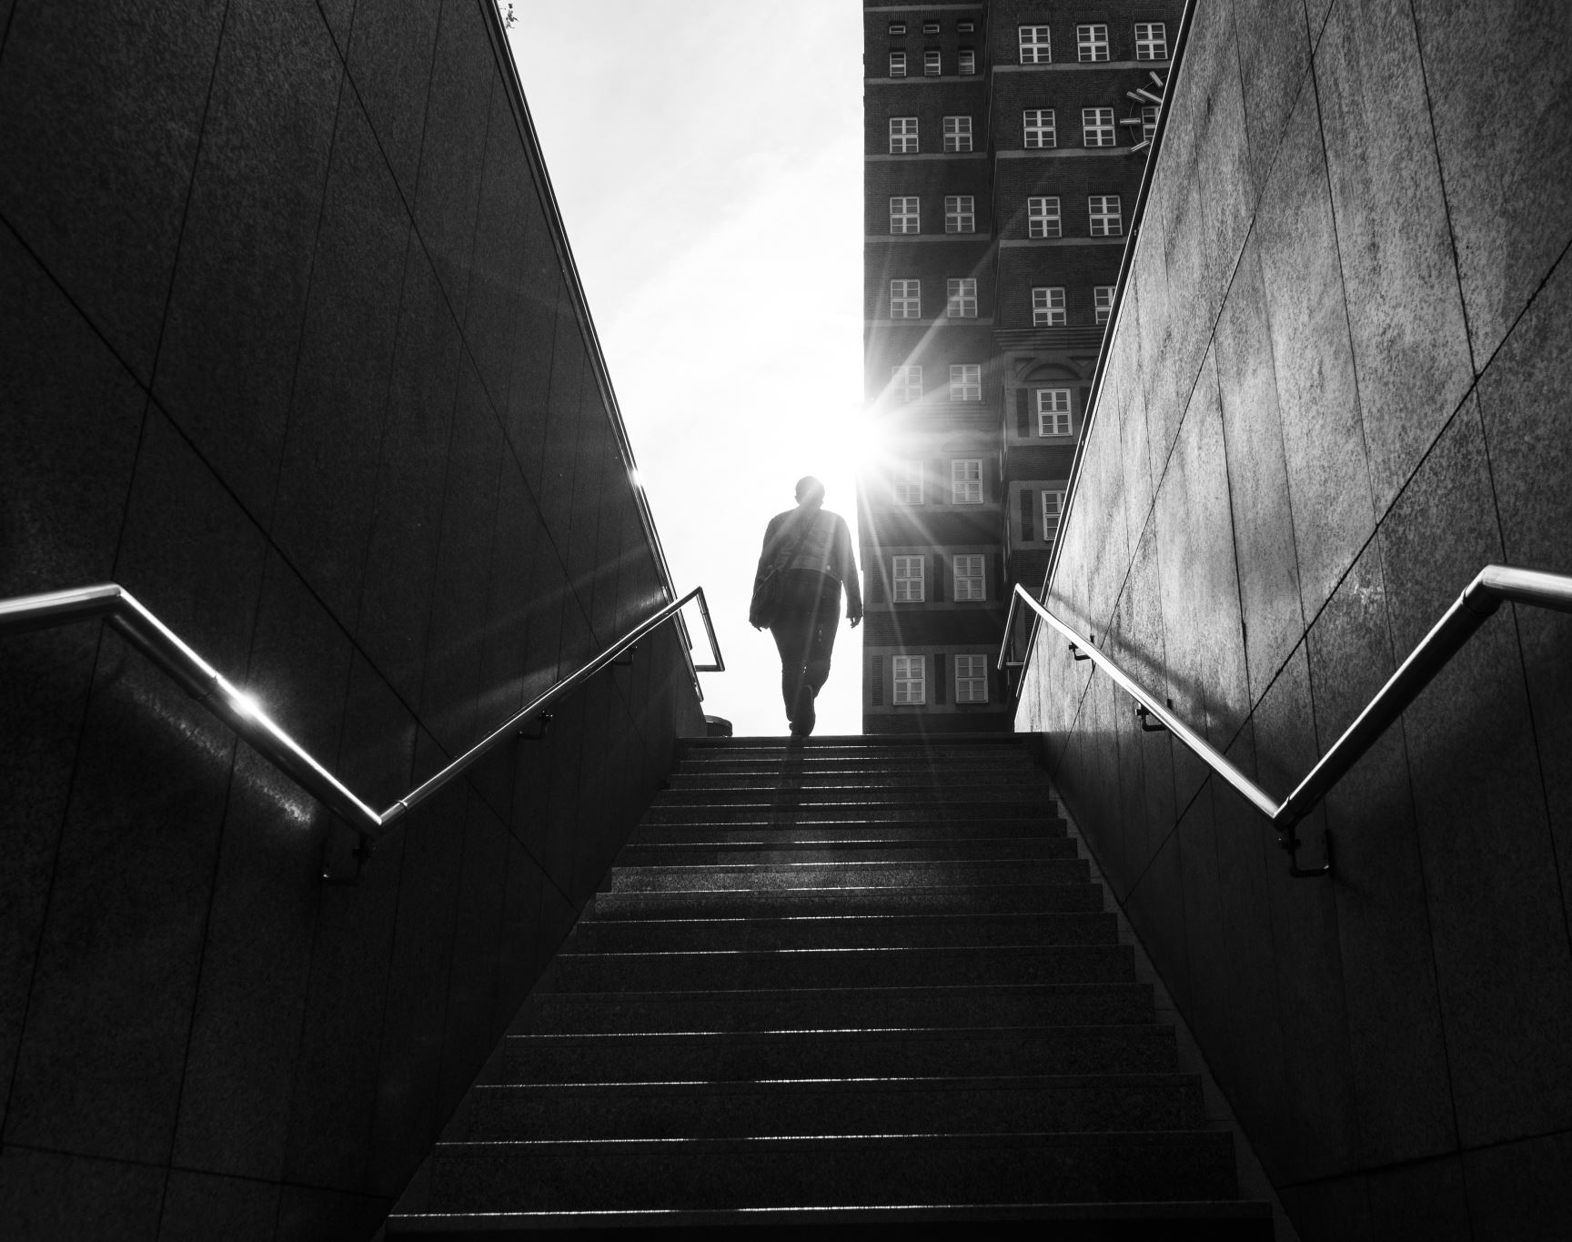
user stories

Slide 10

Aaron Ngo
engineer, likes badminton and reading
Challenges / frustrations:
Poor time management
Kids sometimes forgets to do homework
Keeping track of all the household duties and work responsibilities is difficult

Slide 11
Aaron Ngo
Aaron is a working adult with family and work responsibilities.
He wants to solve his poor time management problems and keep track of tasks so that he can spend more quality time with his family members by going to play badminton with them. This also allows him to have more free time to read and relax instead of keeping all of the tasks due in his head to remember.

Slide 12
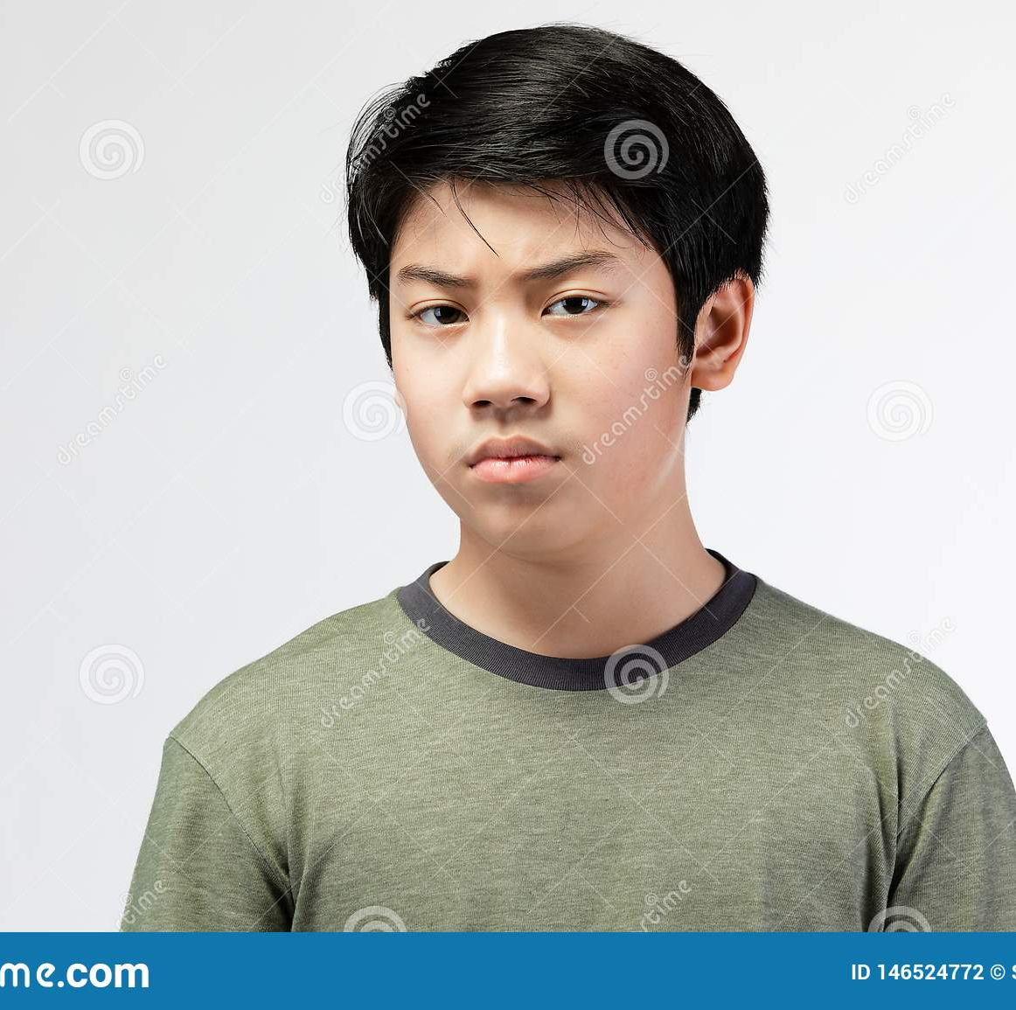
Tyson Ngo
student, likes badminton and gaming
Challenges / frustrations:
Forgets to do homework frequently
Sleeps very late because I have a poor awareness of how much I game.
Struggling in school, specifically chemistry.

Slide 13
Tyson Ngo
Tyson is an irresponsible student / teenager.
He wants to complete his homework on time and sleep at a reasonable hour so that he can improve his grades and maintain his parents’ trust in him and thus be able to play more video games.

Slide 14
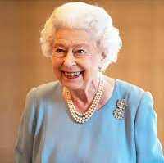
Lisbeth Alexandra
Retired, Ex-Marine Corps, likes playing chess (favorite piece is the Queen), and long walks on the beach
Challenges / frustrations:
Forgetful, especially when it comes to attending chess tournaments and of what has happened in the past (like the day before). Likely due to my Alzheimer’s condition.
Difficult to connect with grandchildren due to the generational gap between us, where we grew up in different worlds.
Have not improved chess ELO rating in the last 3 years.

Slide 15
Lisbeth Alexandra
Lisbeth is a retired elderly who is diagnosed with Alzheimer’s.
She wants to be more independent in taking medicines and going to chess tournaments so that she can be less reliant on her family members to remind her of life’s simple daily tasks, which lets them worry less about her health.

Slide 16
Features / Functionalities | Why feature is needed? | Priority level
To-do list able to add a priority level tag | To allow users to prioritize work according to how important it is | High
To-do list able to set tasks as recurring task | Easier to set events such as birthdays, grocery shopping | High
Camera function to take pictures to be added into diary / to-do list | Users with poor memory can benefit from having photo evidence of what they did in the past to remind them of tasks. | High
Calendar view of events and tasks from to-do-list | More user-friendly design to give a bird’s eye view of the future | Medium
Set mini-tasks and due dates within a task | To split up a big project into smaller parts to be completed by a certain time period | Medium
Password protection (PIN / biometric fingerprint) | Increases privacy and security of diary. Can be turned on/off for certain pages of the diary. | Medium
Timetable | To help students and working adults organize their time better | Low

Slide 17

How many of those did I implement?

Slide 18
modifications were made to the features
tags
become customizable tags to add their own priority tags to be used.
color gradient of days until due date to show how urgent the task is.
camera function
modified to be mood indicator of the day because memory is closely linked to emotion, by seeing the emotion can remember better about the day
can be added as a feature in the future
recurring tasks
I have no excuses :P

Slide 19
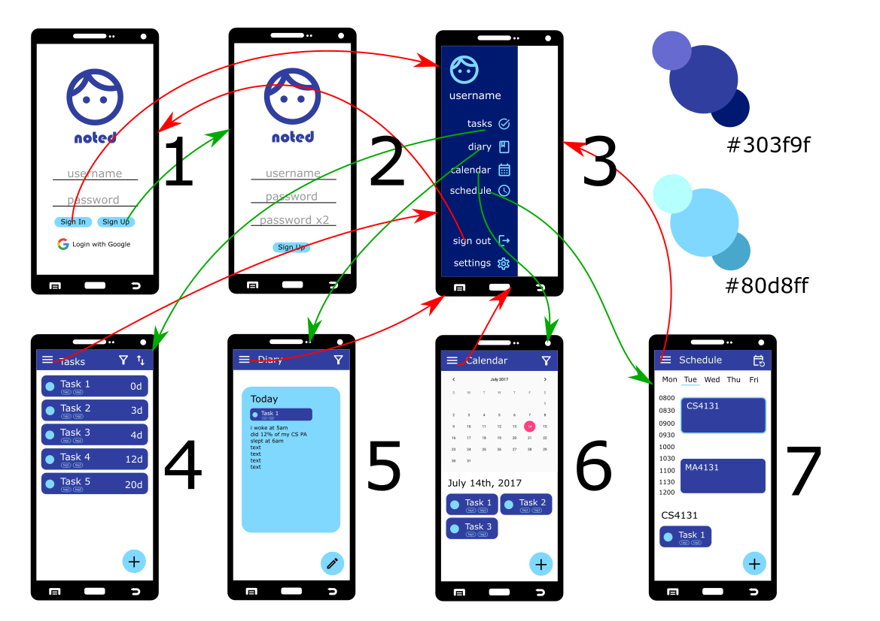
high-fi prototype made in Inkscape never again
Notes:
remember to explain differences between prototype and app

Slide 20

actual app
Notes:
remember to explain differences between prototype and app

Slide 21
the logo (made in svg (original))
Notes:
remember to explain differences between prototype and app

Slide 22
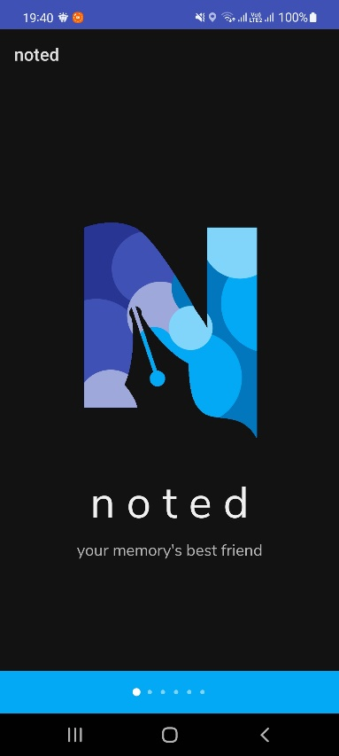
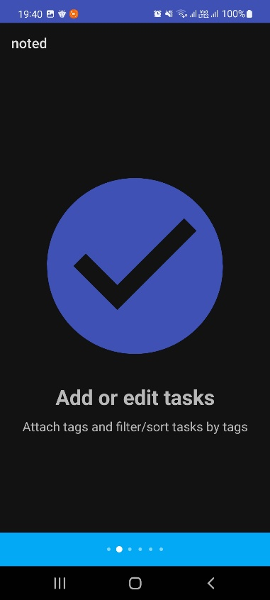
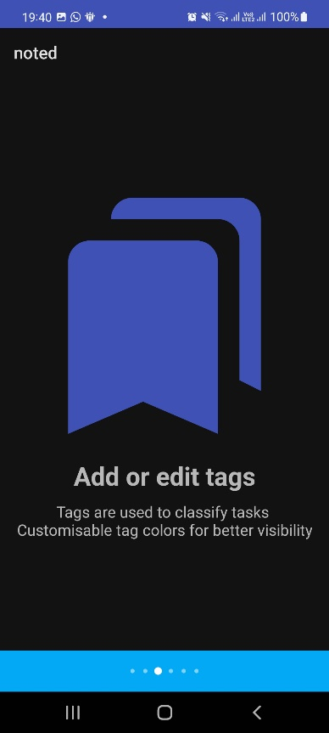
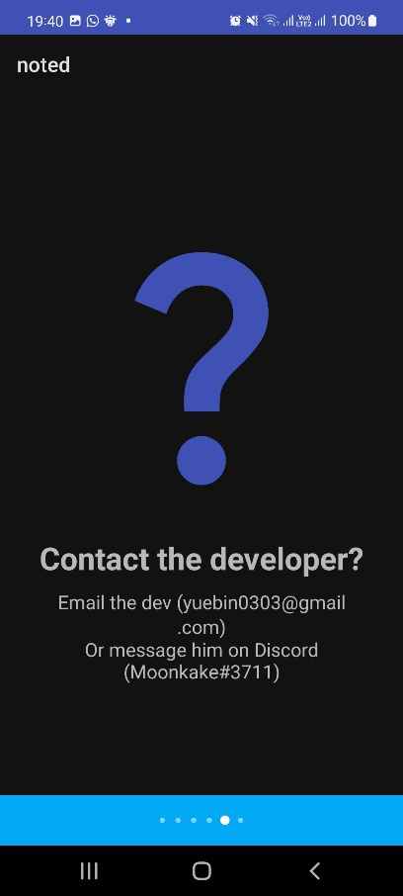
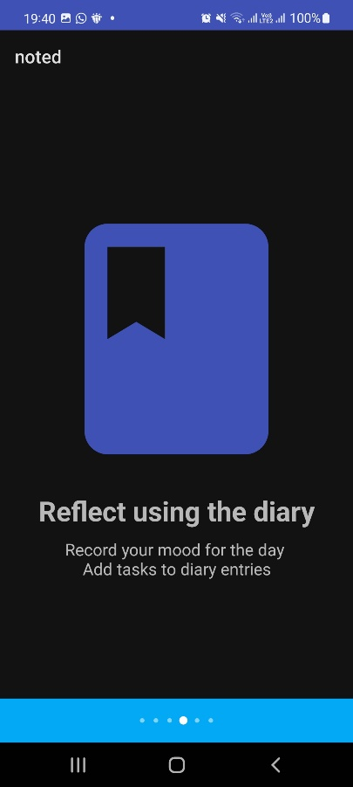
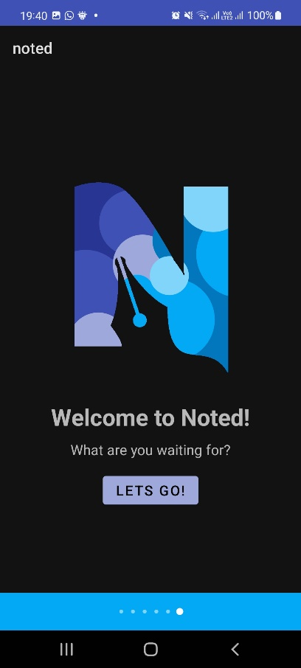
onboarding
Notes:
remember to explain differences between prototype and app

Slide 23
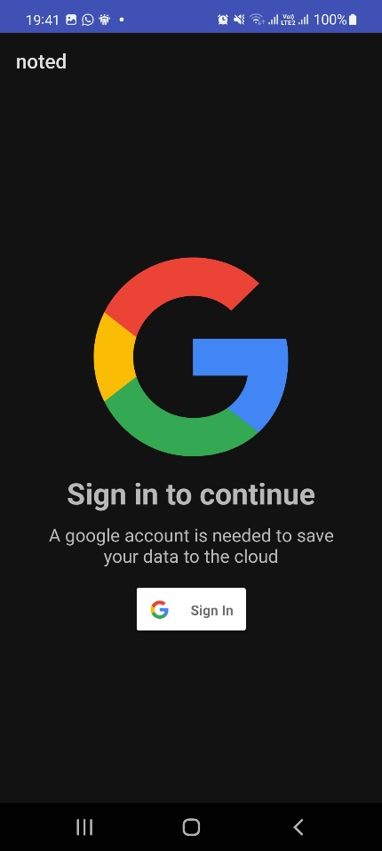
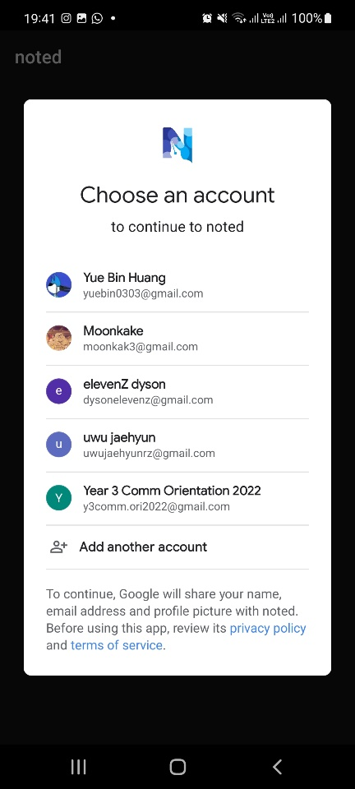
sign in
Notes:
remember to explain differences between prototype and app

Slide 24
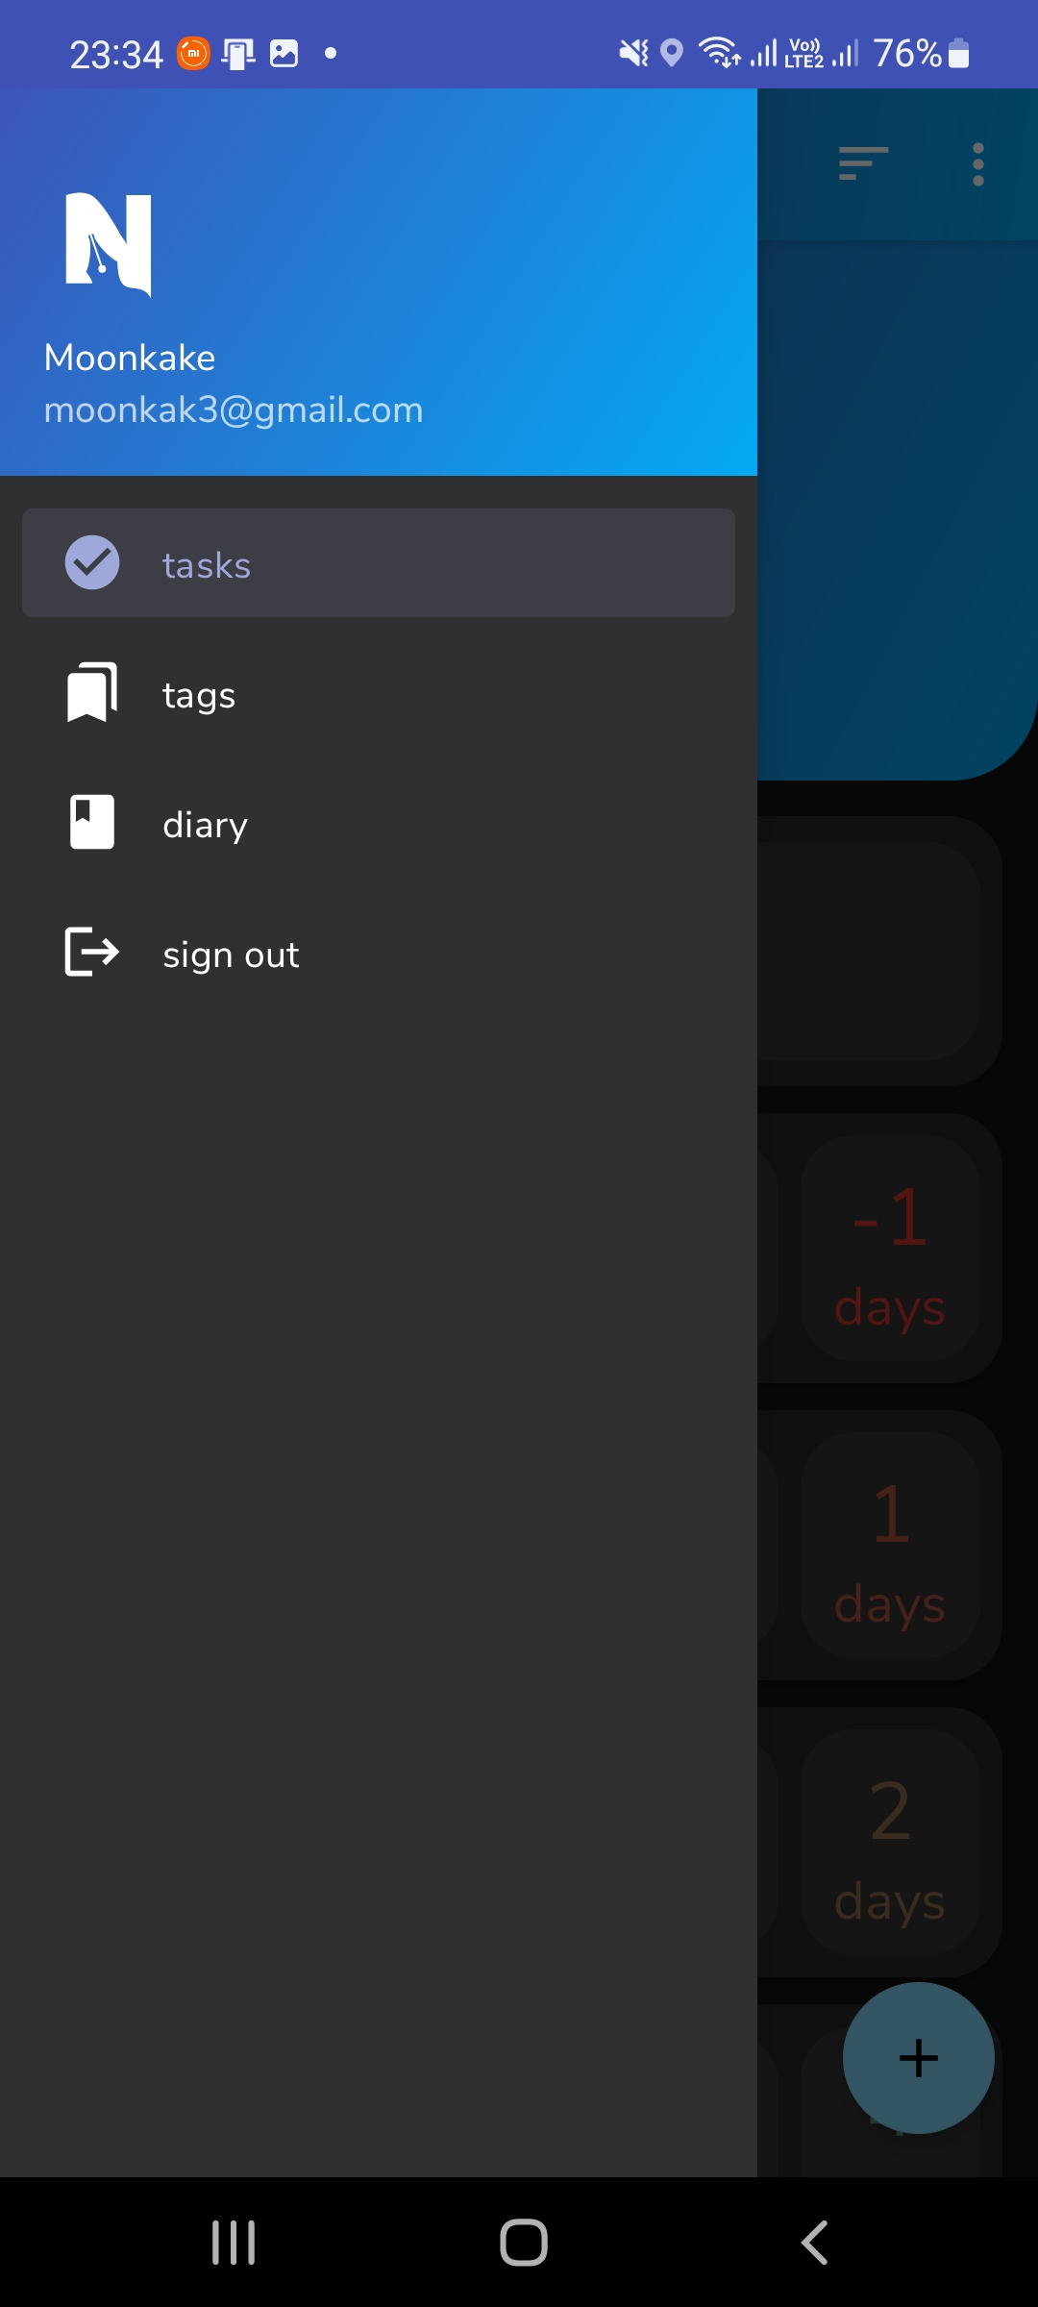
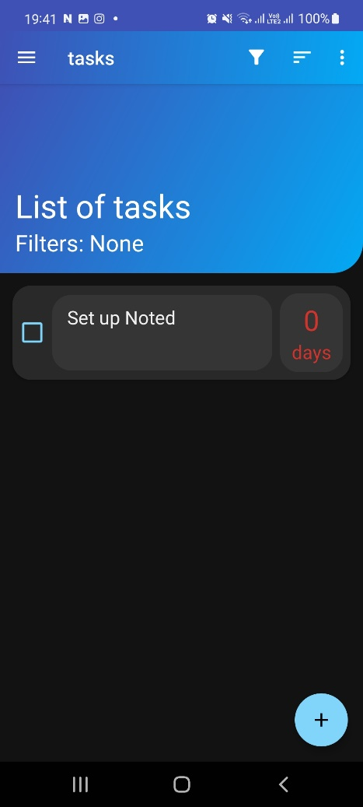
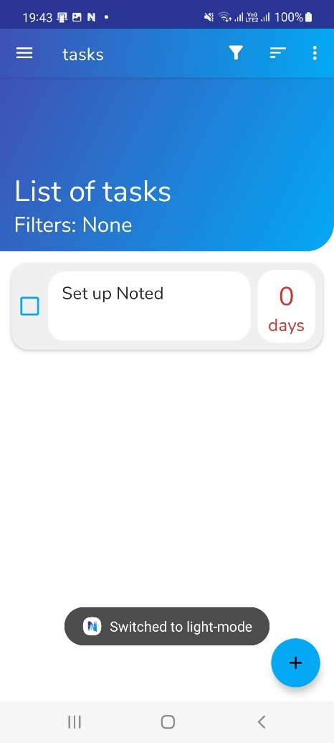
Notes:
mention default task

Slide 25
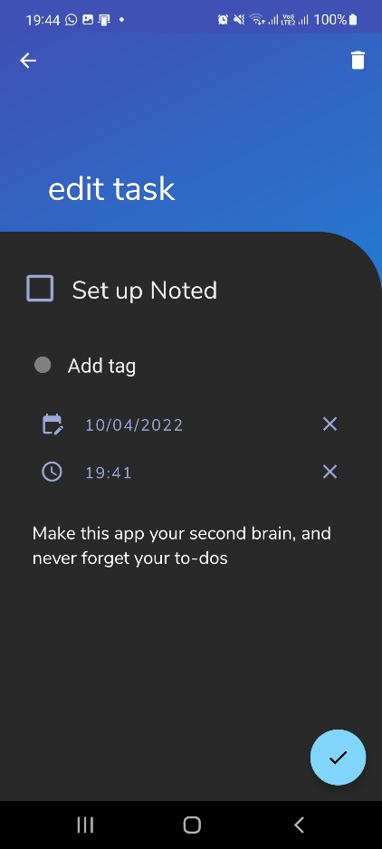
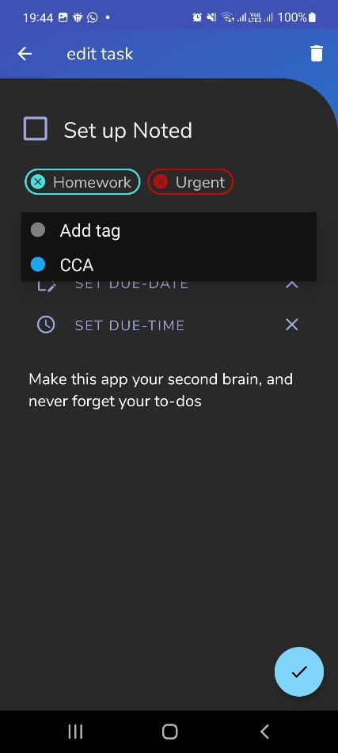
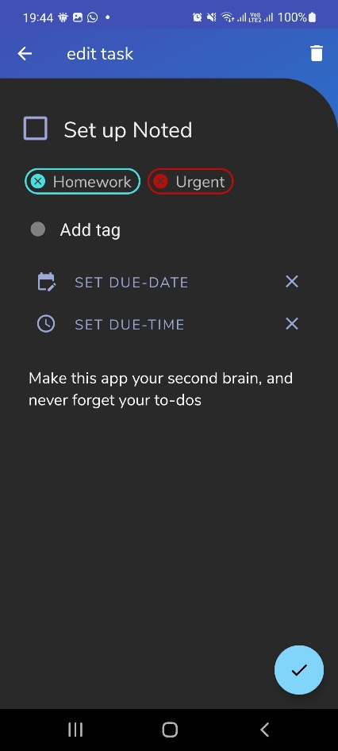
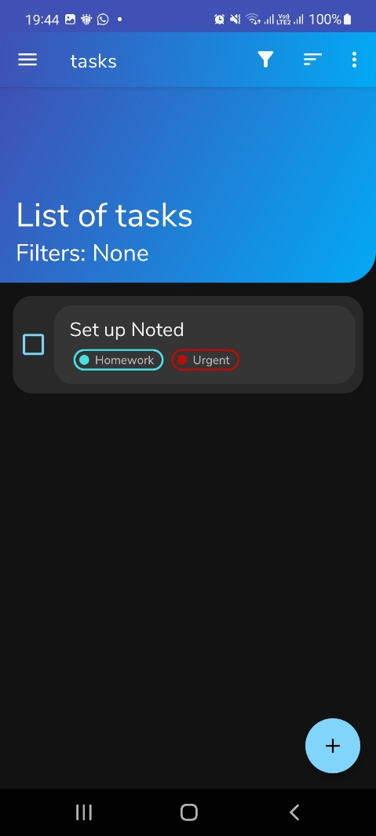

Slide 26
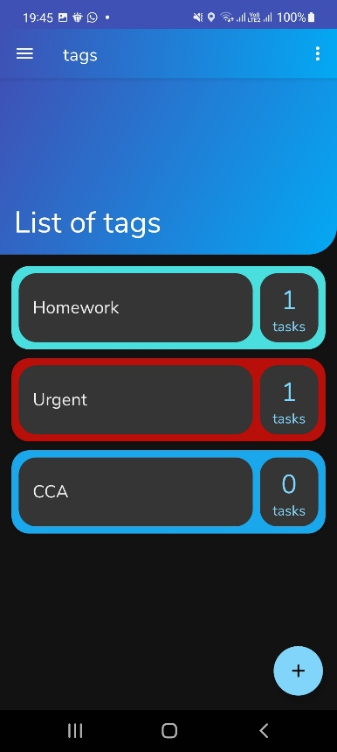
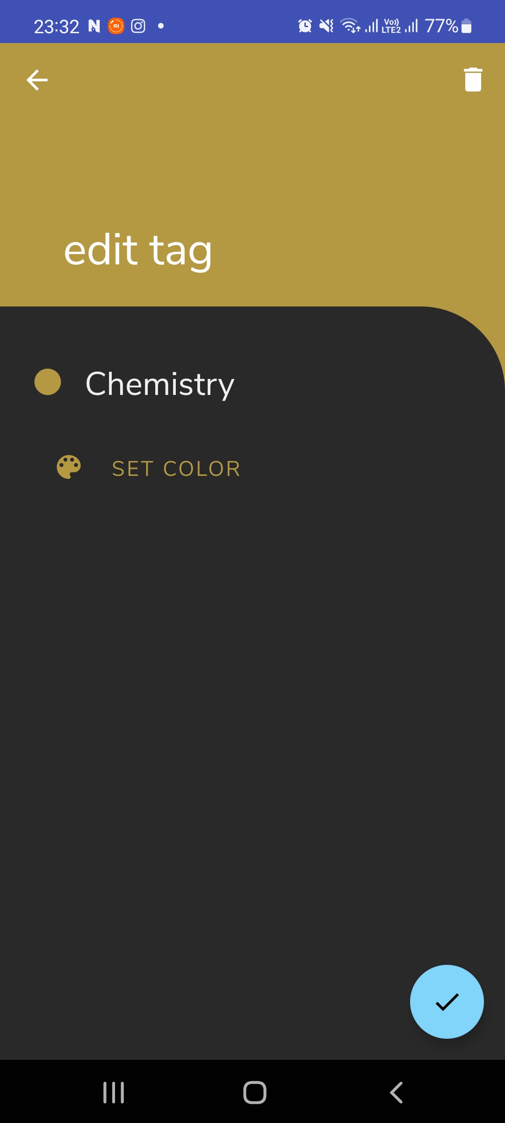
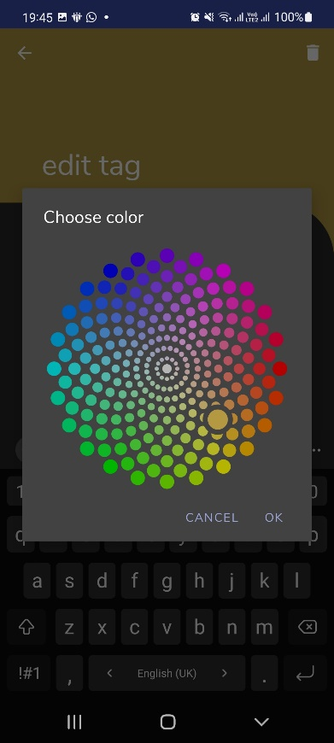
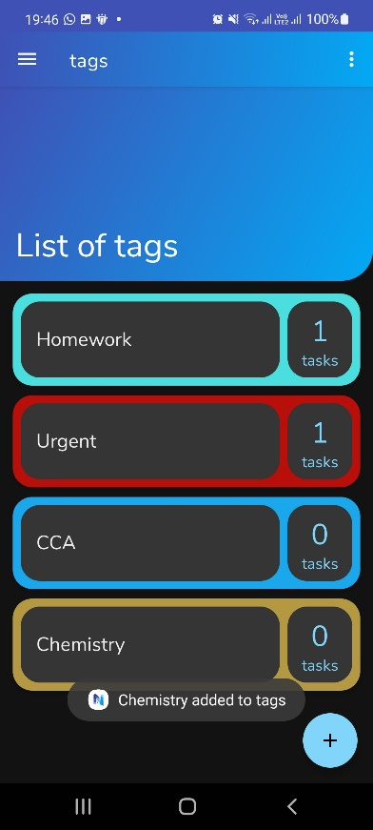
Notes:
mention default tags

Slide 27
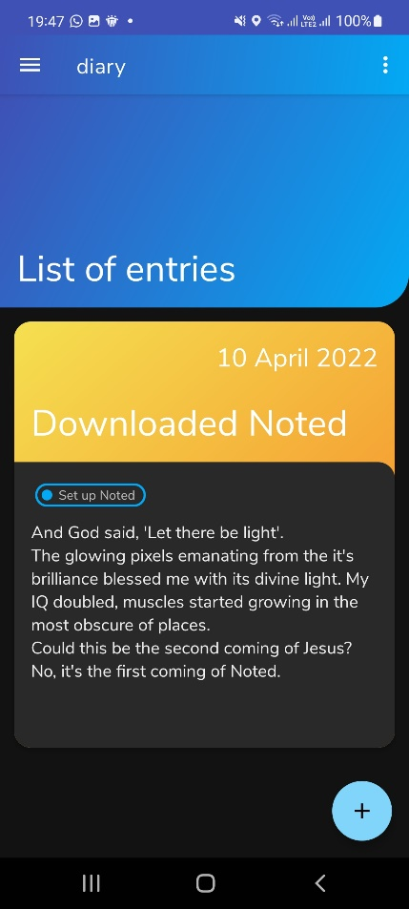
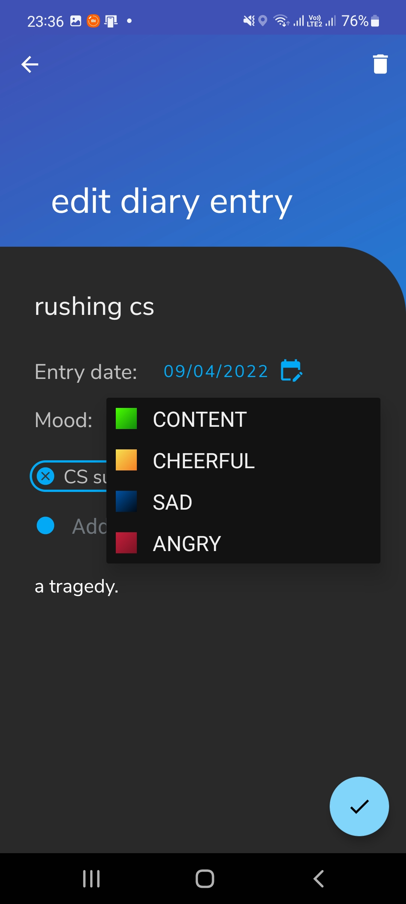
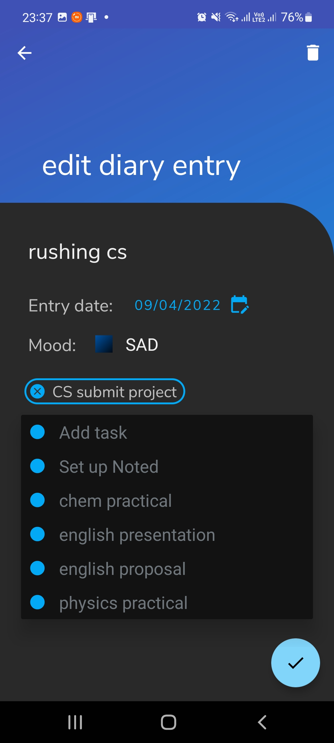
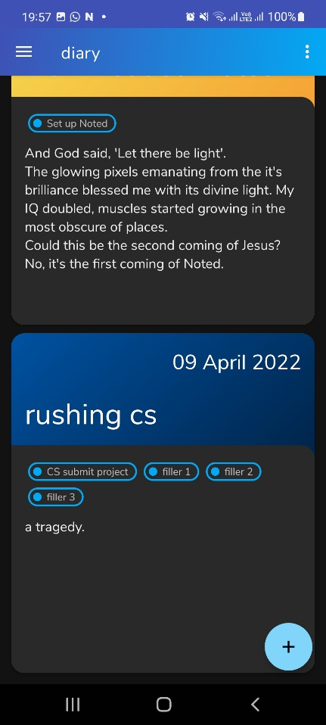
Notes:
mention default diary entry

Slide 28
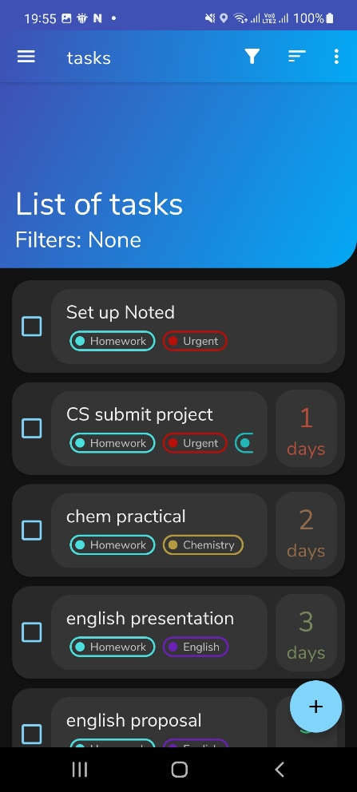
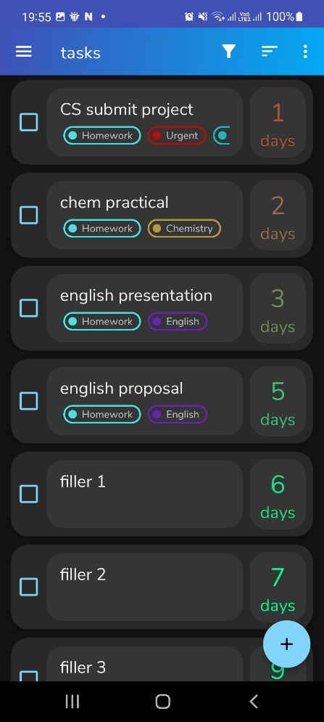
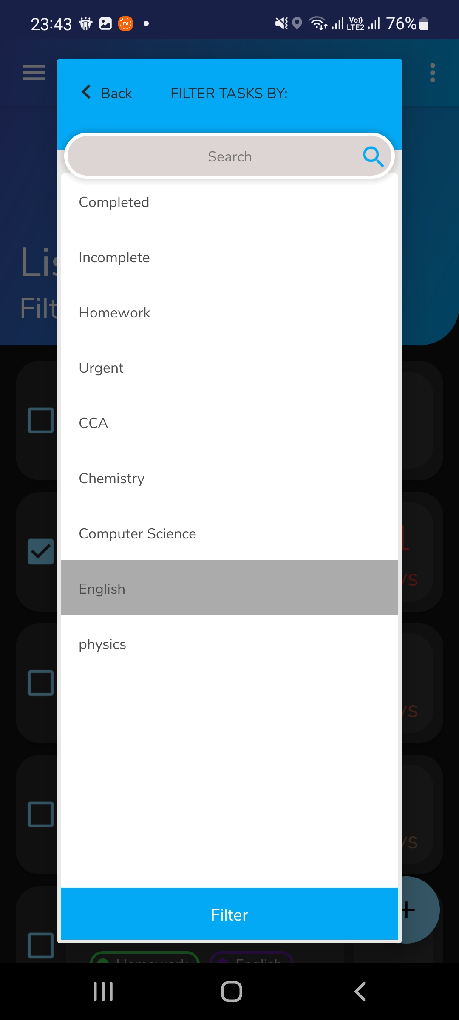
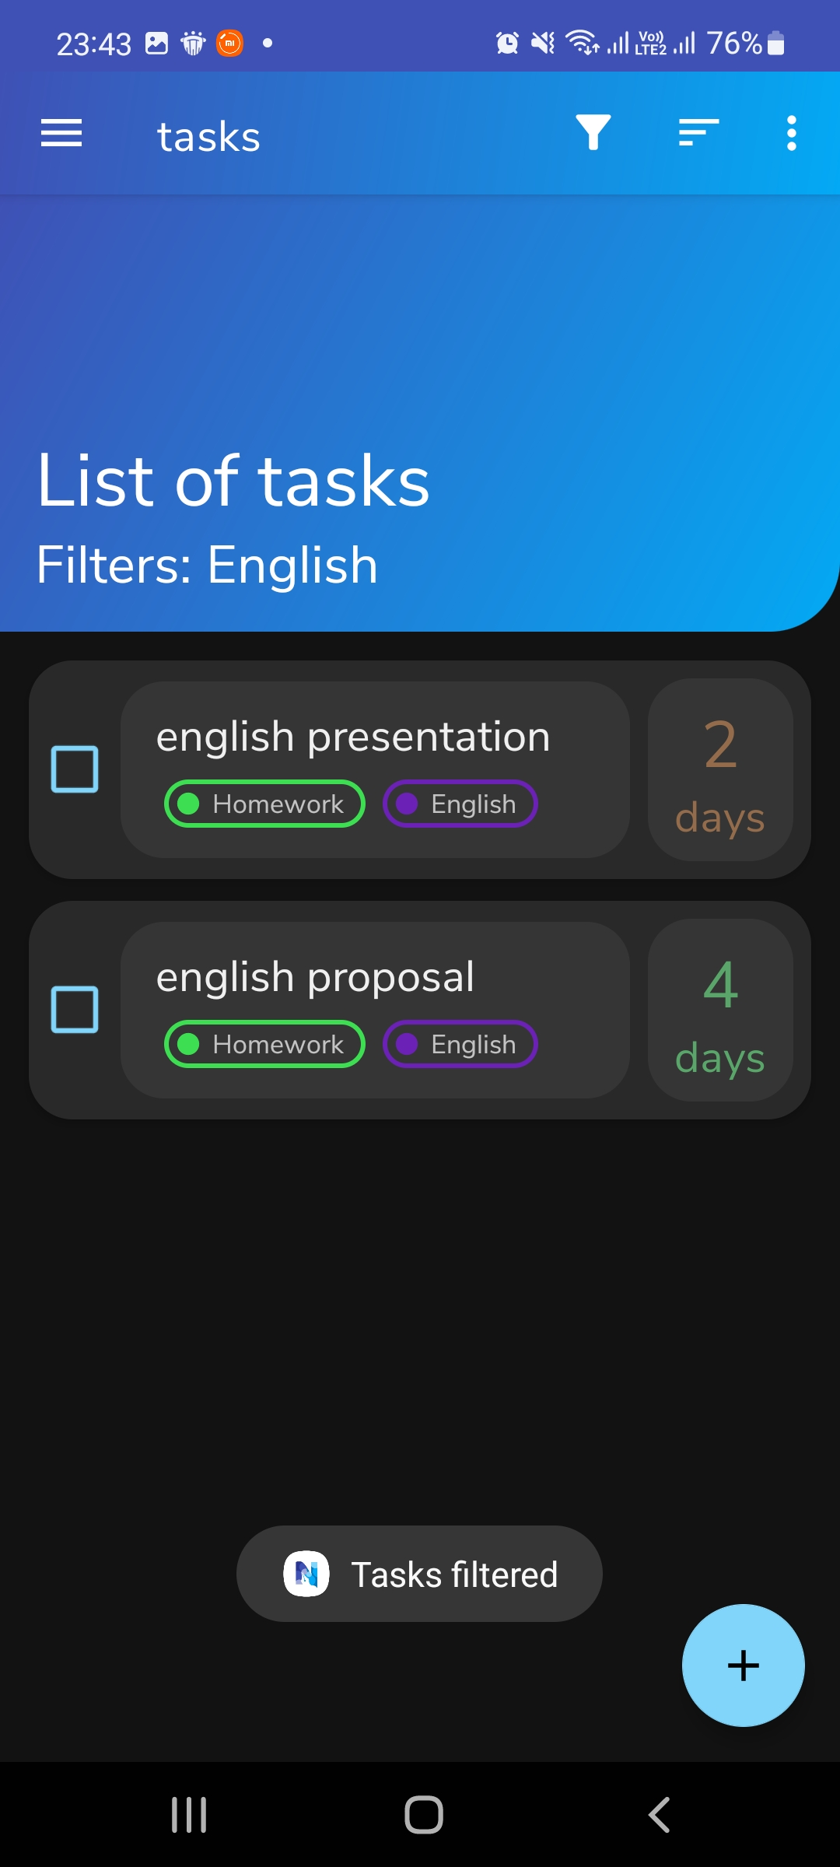
Notes:
color gradient, filter AND sort

Slide 29
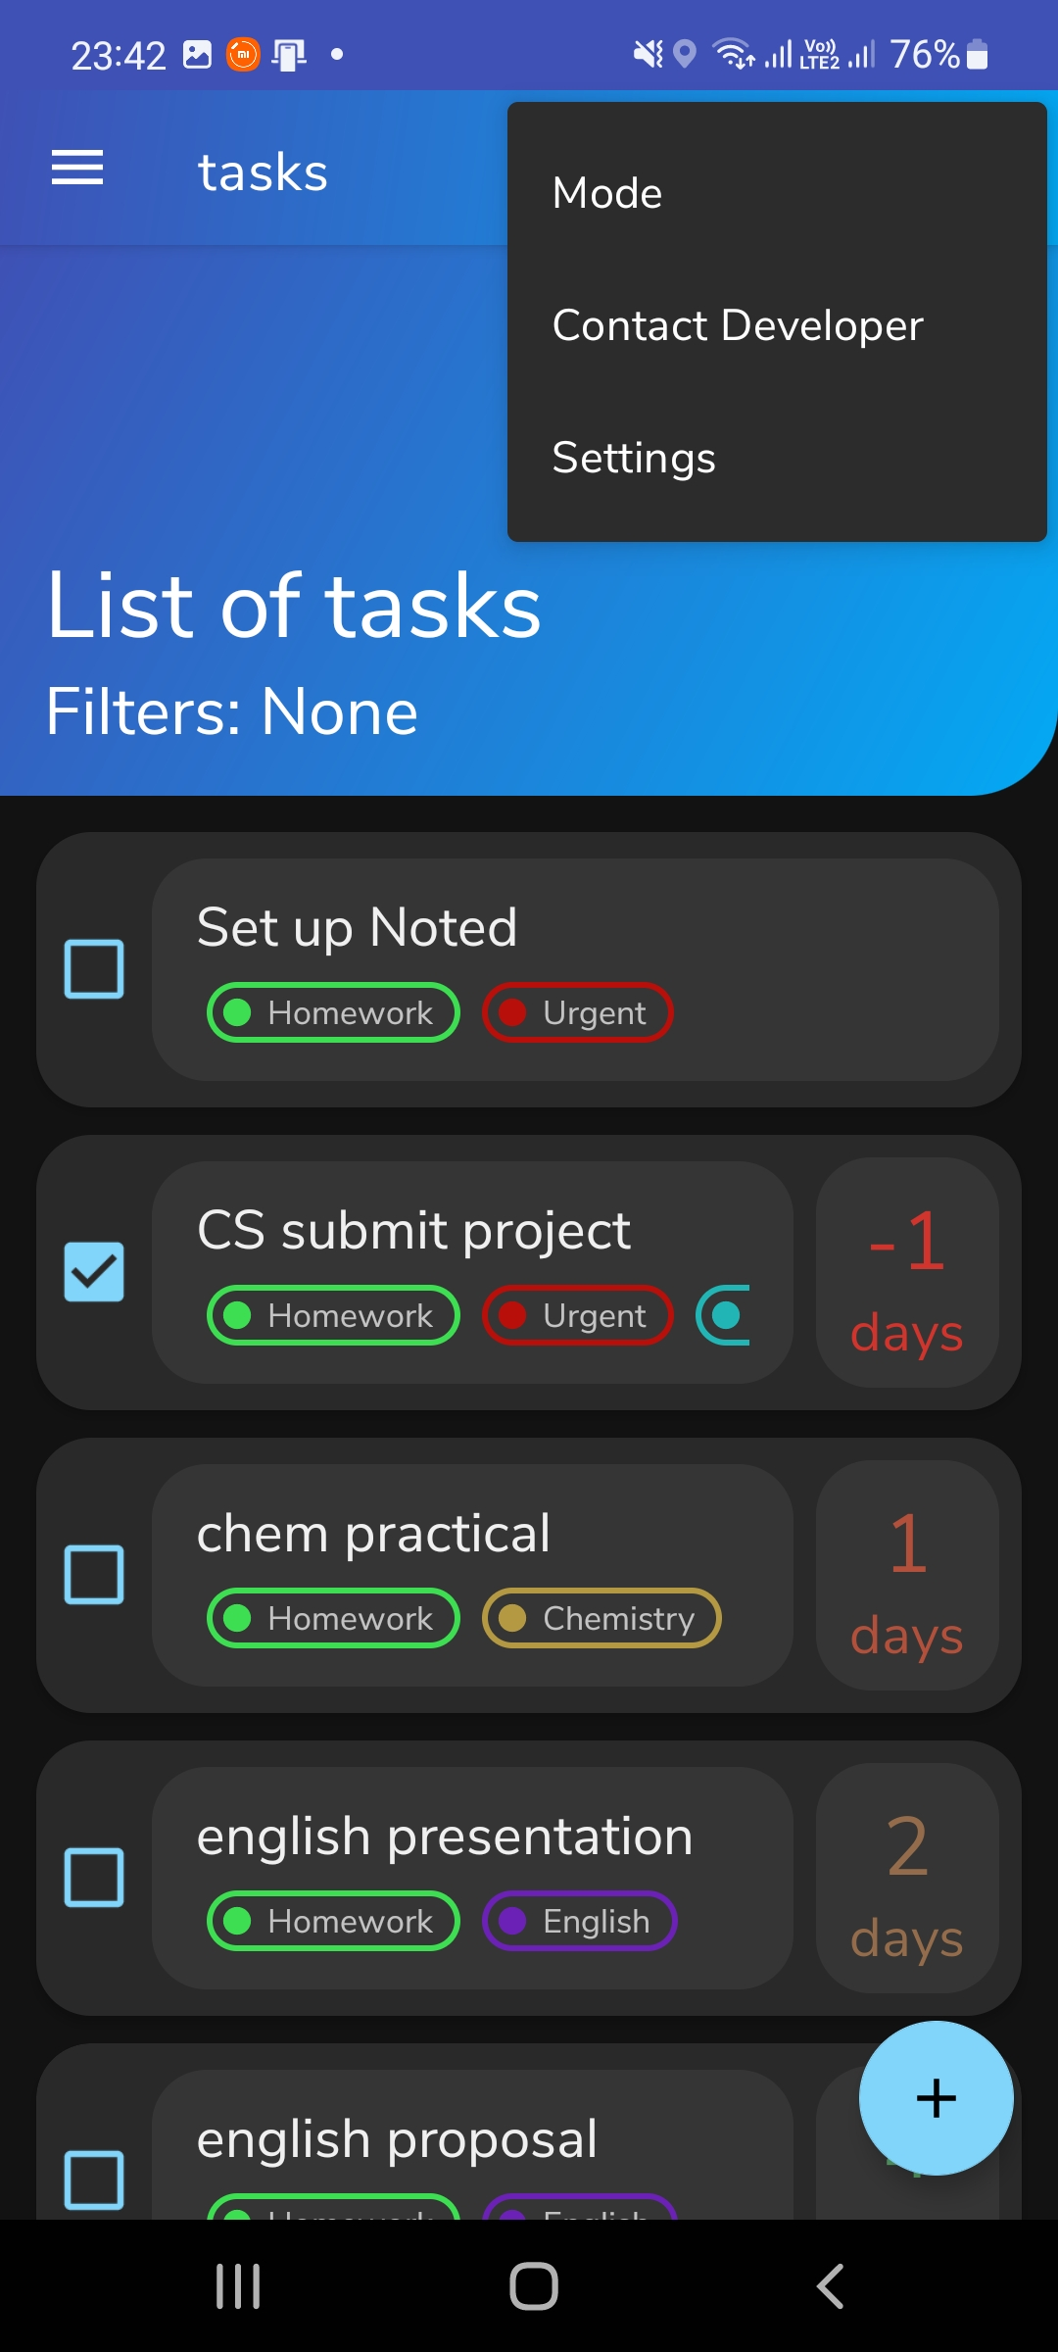
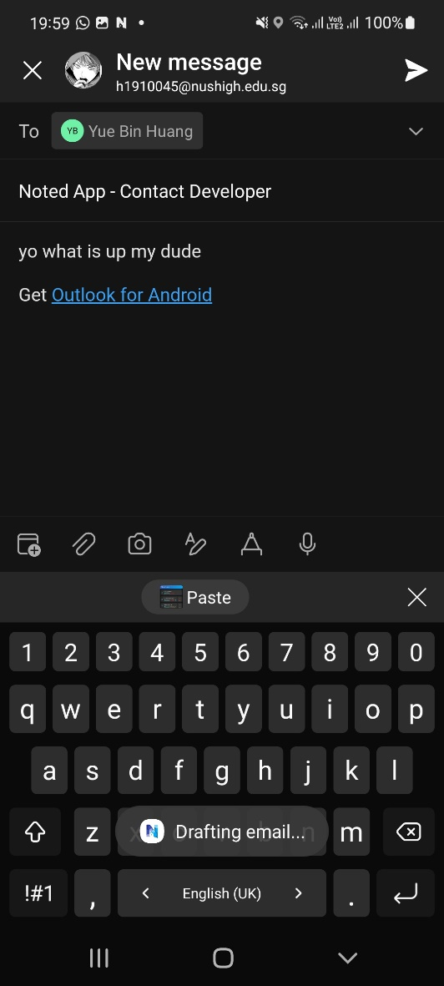
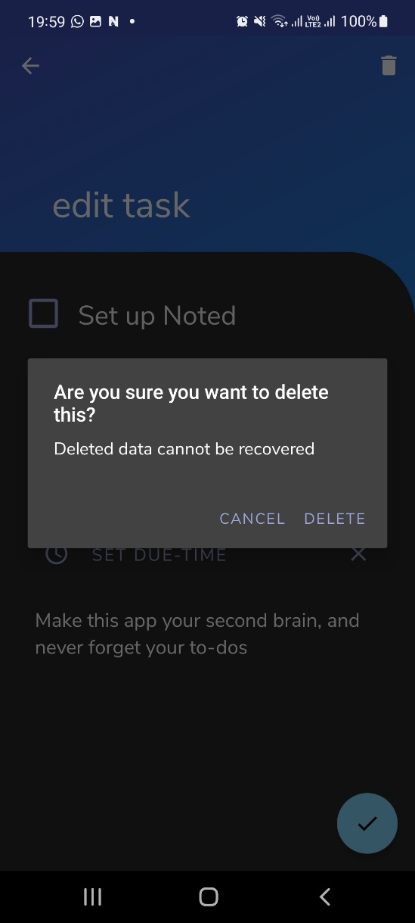
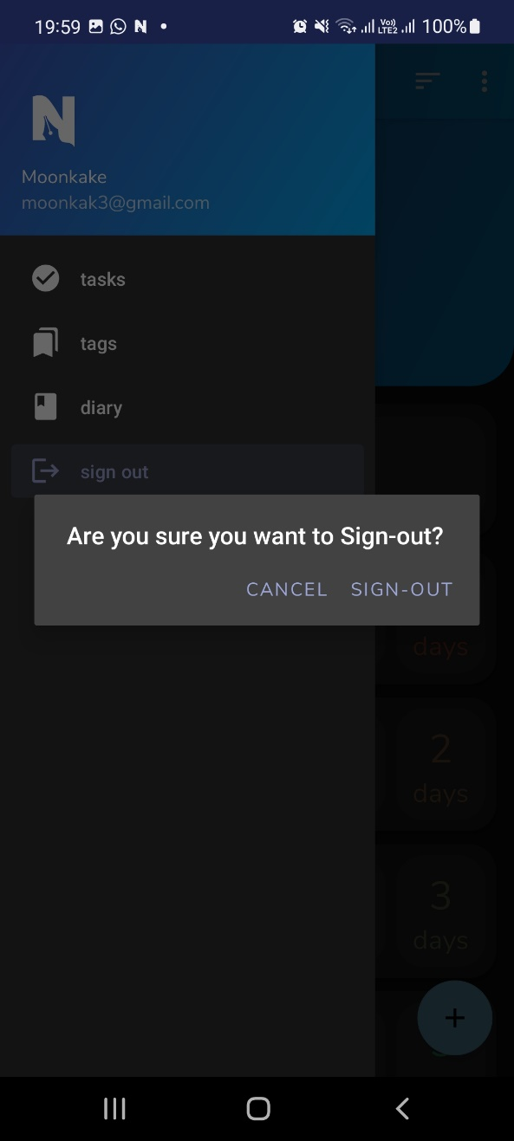
Notes:
additional quality of life additions, mention notification sent (but its useless, no one really reads notifs)

Slide 30
usability study 👍
because it is important to have an open mind and be accommodating to the people you are developing the app for.

Slide 31
usability study procedure
What they like about the app
What they dislike about the app
Which icons or features or text were unclear
Any bugs? (please say no)
What they would like to see implemented in the app
Feedback was recorded on WhatsApp, or in the case of my parents I translate from Chinese 💀 and type it out in English.

Slide 32
feedback - mother
Liked the part where you can order tasks by date due, date created to see urgency of tasks. Liked the color-coding, especially the diary mood setting colors.
Made me realise it would be cool if I incorporated multiple languages as a setting to be inclusive of all languages.

Slide 33
feedback - father
Tags should not be grouped with Diary and Tasks in the navigation bar, as they are not the same type of thing. Tag is a tool while Tasks and Diary entries are actual stuff.
For the days due counter on the right, if the task has a due time set, it should switch from showing days until the due date into hours/minutes until due time if the task is due on the day itself.

Slide 34
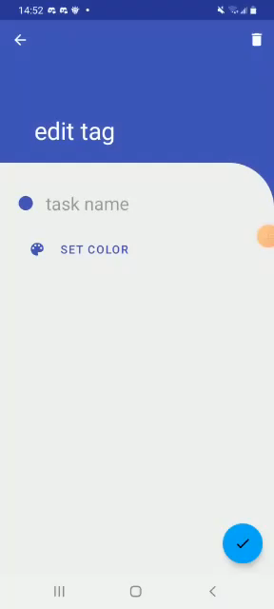
feedback – friends (x4)
Liked the color scheme of the design.
Drag task card to select it or delete it in bulk.
Told me that the text was not visible on the spinners because of some weird applicationContext thing, making the spinner item layouts being not responsive to text color being dependent on the theme being day or night.
Add the app as a widget on the home screen so that there is no need to open the app to see the tasks.
Add an alarm for when a task is due (like the alarm in the phone clock)

Slide 35
can we do better?
desktop app with the google sign in as well to share the data not only across android devices but also across platforms
more offline support, as app is dependent on internet connection.
polish and make UI cleaner and less cluttered
restructure how data is retrieved and saved to firebase
minor bugs here and there
add proposed functionalities from proposal
add improvements suggested by the users

Slide 36
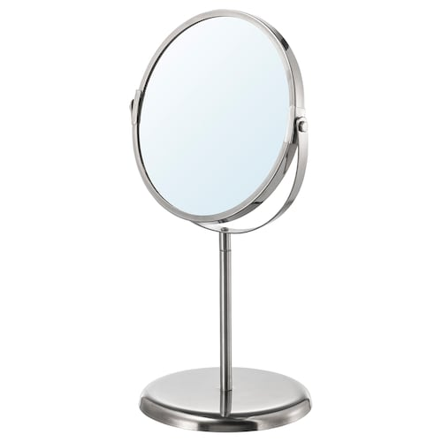
reflections
manage my time better by prioritizing what I need to add first for the app
now possible with Noted ☺
read up how to use a database properly first instead going in blindfolded, resulted in a lot of time wasted fixing bad code

Slide 37
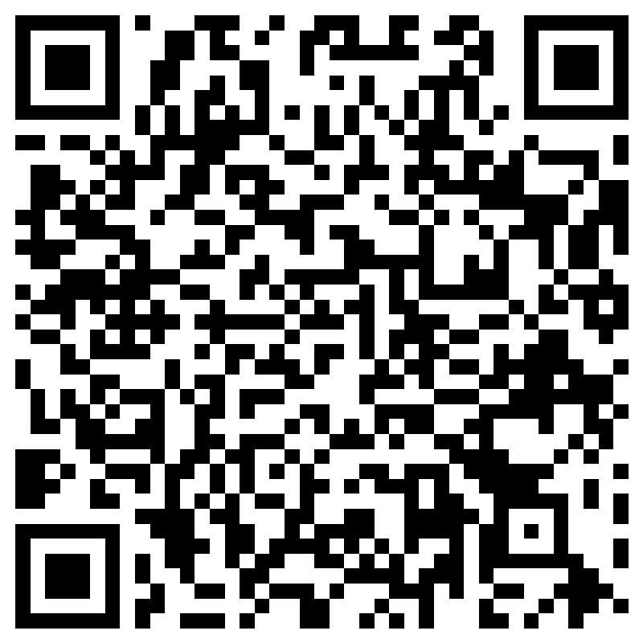
thank you!
imagine how cool would it be if you could noted down this wonderful presentation in a diary somewhere
QR code for feedback
(5 star rating 👍)

